Slide 1
Stress & Worker Well-Being
Chapter 10

Slide 2
Overview
Modules 10.1 & 10.3 – The Problem of Stress & Reducing/Managing Stress
Module 10.2 – Theories of Stress
Module 10.4 – Violence at Work (Not on Test)

Slide 3
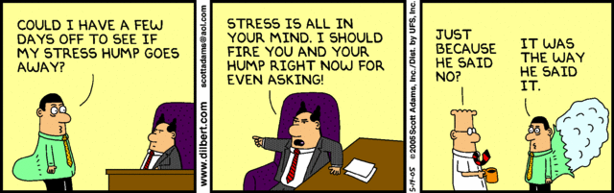
Stress & Worker Well-Being
Modules 10.1& 10.3

Slide 4
The Problem of Stress
40% of workers report their job is “very or extremely stressful” (NIOSH)
65% of Americans cite work as #1 stressor in their lives; 33% experience chronic stress (APA)
75% of workers believe there is more on-the-job stress than a generation ago (NIOSH)
$200 billion = annual cost of work-related stress to U.S. organizations (NIOSH)
€20 billion = annual cost of work-related stress to organizations in EU-15 countries (EU-OSHA)
€617 billion = annual cost of work-related depression to organizations in EU-15 countries (EU-OSHA)
Statistics from NIOSH, APA, and EU-OSHA

Slide 5
What is stress?
Stress
The experience of opportunities or threats that people perceive as important and also perceive they might not be able to handle or deal with effectively.
_________
_________
_________
the psychological and physical reaction to
Stress is
life events or situations.

Slide 6
Why study stress?
Key Terms
Eustress
Distress
Performance
Stress

Slide 7
Framework for the Study of Stress (Kahn & Byosiere, 1992)
Potential Stressors
Personal stressors
Job-related stressors
Group & organization-related stressors
Work-Life interface
Potential Consequences
Perception & Cognition
Properties of Person
& Situation

Slide 8
Measuring Stress: the Social Readjustment Rating Scale
Commonly used instrument for assessing life stress developed by Holmes and Rahe (1967)
Includes 43 stressful life events
Correlation between stress score and the likelihood of becoming sick in the near future is .30

Slide 9
Stress
A college survey, 44% of students reported experiencing stress related to:
personal relationships
death or illness of someone close
parental conflict

Slide 10
Stressors
Job Related Stressors
Role Stressors
Conflict
Ambiguity
Overload
Underload – remember the JCM??
Emotional Labor: The regulation of one’s emotions to meet job/ organizational demands

Slide 11
Group/Organization-Related Stressors
Interpersonal Conflict/ Isolation
Job Demands
High Responsibility
High Risk
Work Conditions

Slide 12
Work-Life Interface Stressors
Work → Family Conflict (WFC)
Family → Work Conflict (FWC)
Child care
Elder care
Personal values/beliefs
What you value does not match what the position provides ($, altruism, etc.)
Job duties interfere with values/beliefs

Slide 13
How do you perceive stress?
Potential Stressors
Personal stressors
Job-related stressors
Group & organization-related stressors
Work-Life interface
Potential Consequences
Perception & Cognition
The Appraisal Process
Properties of Person
& Situation

Slide 14
Perception & Cognition
Different people react differently to stressors that are objectively the same.
_________ Appraisal: Is this stressor positive, negative, or neither?
_________ Appraisal: What can I do about the stressor? Will I be able to cope?

Slide 15
What are consequences of stress?
Potential Stressors
Personal stressors
Job-related stressors
Group & organization-related stressors
Work-Life interface
Potential Consequences
Physiological
Psychological
Behavioral
Perception & Cognition
The Appraisal Process
Properties of Person
& Situation

Slide 16
Consequences of Stress
Physical:
Minor physical distress (headaches, stomachaches, trouble sleeping)
Infectious disease (colds & flu)
Major degenerative illnesses (heart disease, high blood pressure, ulcers)

Slide 17
Consequences of Stress
Psychological:
Anxiety
Mood
Aggression (incivility, abuse, violence!!)
Burnout

Slide 18
Consequences of Stress
Behavioral:
Lower Performance
Attention/ Cognitive Functioning
Counterproductive Work Behavior
Alcohol/Drug Abuse
Abuse at work?
Family conflict?

Slide 19
What moderates the stress “process”?
Potential Stressors
Personal stressors
Job-related stressors
Group & organization-related stressors
Work-Life interface
Potential Consequences
Physiological
Psychological
Behavioral
Perception & Cognition
The Appraisal Process
Properties of Person
& Situation

Slide 20
Situational Characteristics (CUPS)
Is the situation controllable?
Is the situation understandable?
Is the situation predictable?*
Is there social support in this situation?

Slide 21
Individual Characteristics
Negative Affect / Pessimism
Type A / Type B Personality
Internal Locus of Control / “Resilience”
Ability

Slide 22
What can we do about stress?
 | Individual | Organization
Problem-Based (more effective) “Primary” | I Learn better time management | II Flextime
Emotion-Based (less effective) “Secondary/ Tertiary” | III Meditation | IV On-site Gym

Slide 23
Theories of Stress
Module 10.2

Slide 24
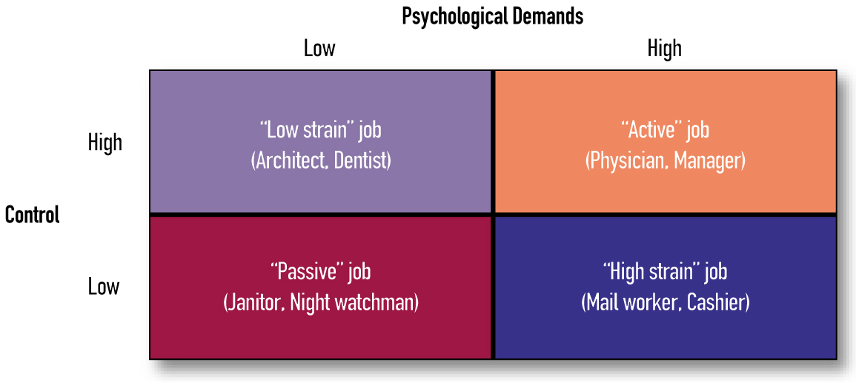
Demand-Control Model
2 factors prominent in producing job stress
Job demands
Workload or intellectual requirements
Control (decision latitude)
Autonomy & discretion for using different skills

Slide 25
Person-Environment Fit Model
Hypothesis: Fit between person & environment determines amount of stress that person perceives
Considers external influences like social support from family & work sources
Person-job fit vs. person-organization fit

Slide 26
Violence at Work
Module 10.4
Notes:
In addition to examples linked where current/former employees attacked other employees. Health care workers subject to workplace violence from patients.

Slide 27
Violence at Work
Many hypotheses for why workplace has become more violent since the early 1990s
Surge in layoffs, mergers, and acquisitions has increased stress
Large # of Baby Boomers = ↓ room for advancement
↑ diversity (multicultural workplace) makes presence of prejudices and biases more likely
↑ drug & alcohol abuse = ↓ inhibitions that prevent violence

Slide 28
Sequence of Violence (Kinney, 1995)
Individual suffers trauma, which creates extreme tension or anxiety
Could be singular event (e.g., job loss or divorce)
Could be cumulative minor events
Individual thinks that problems are unsolvable
Individual projects all responsibility on the situation
Individual’s frame of reference becomes increasingly egocentric
Self-preservation and self-protection gradually become sole objectives
Violent act is perceived as only way out
Violent act is attempted or committed

Slide 29
“Typical” Violent Worker
Most cases of workplace violence involve some feeling of being treated unfairly, & perpetrator has some real or imaginary grievance against organization or a person in the organization
Characteristics of a violent worker
May include: Abuses alcohol, has a history of violence, has difficulty accepting authority, is a white male 25-50 years of age

Slide 30
Theories of Workplace Violence
Frustration-aggression hypothesis
Modern view: Frustration leads to stress reaction & individual expends energy to relieve this stress
“Justice” hypothesis
Proposes that some violent acts can be understood as reactions by an employee against perceived injustice

Slide 31
Special Type of Violence: Bullying
Bullying – Harassing, offending, socially excluding, or assigning humiliating tasks to subordinate repeatedly & over long period of time
Widespread in organizations
Victims often not in control; requires intervention of 3rd party

Slide 32
Conclusions About Workplace Violence
Employees need avenues for communicating concerns about the fairness of organizational decisions that affect them
Managers need to be sensitive to signs of potential trouble in form of individual worker behaviors

